Slide 1
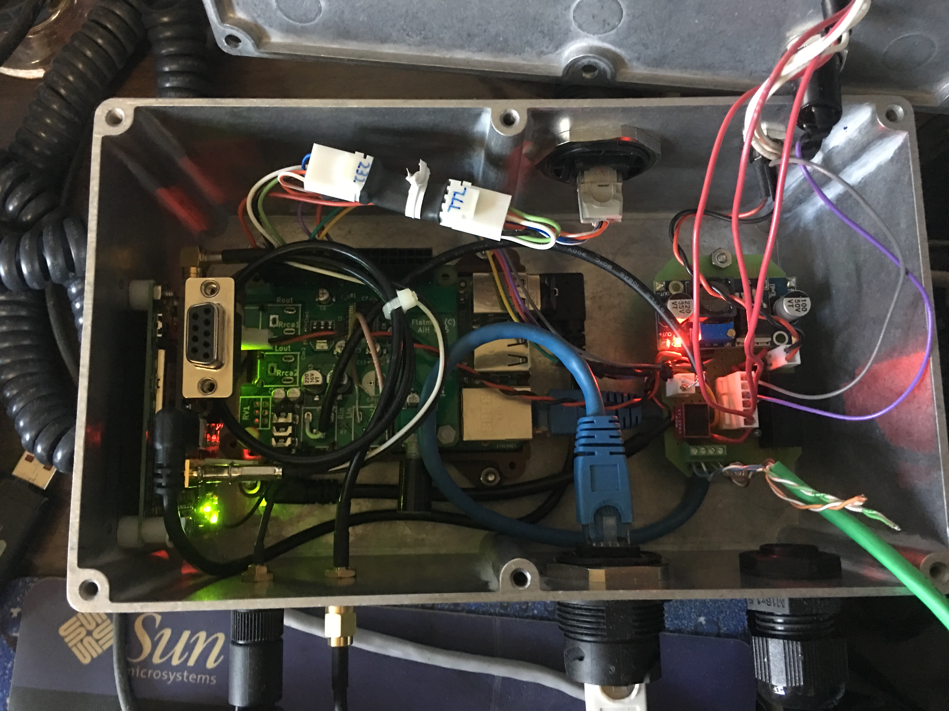
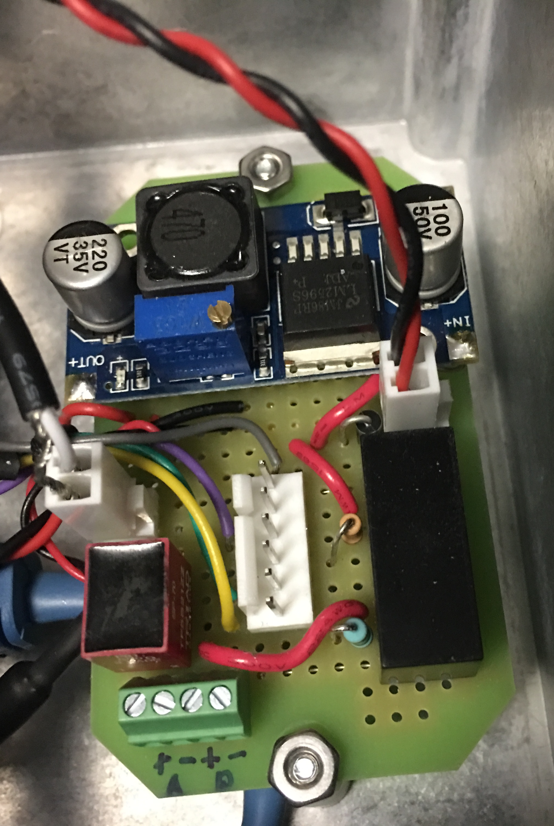
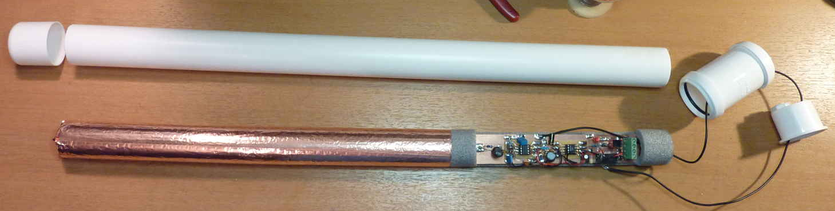
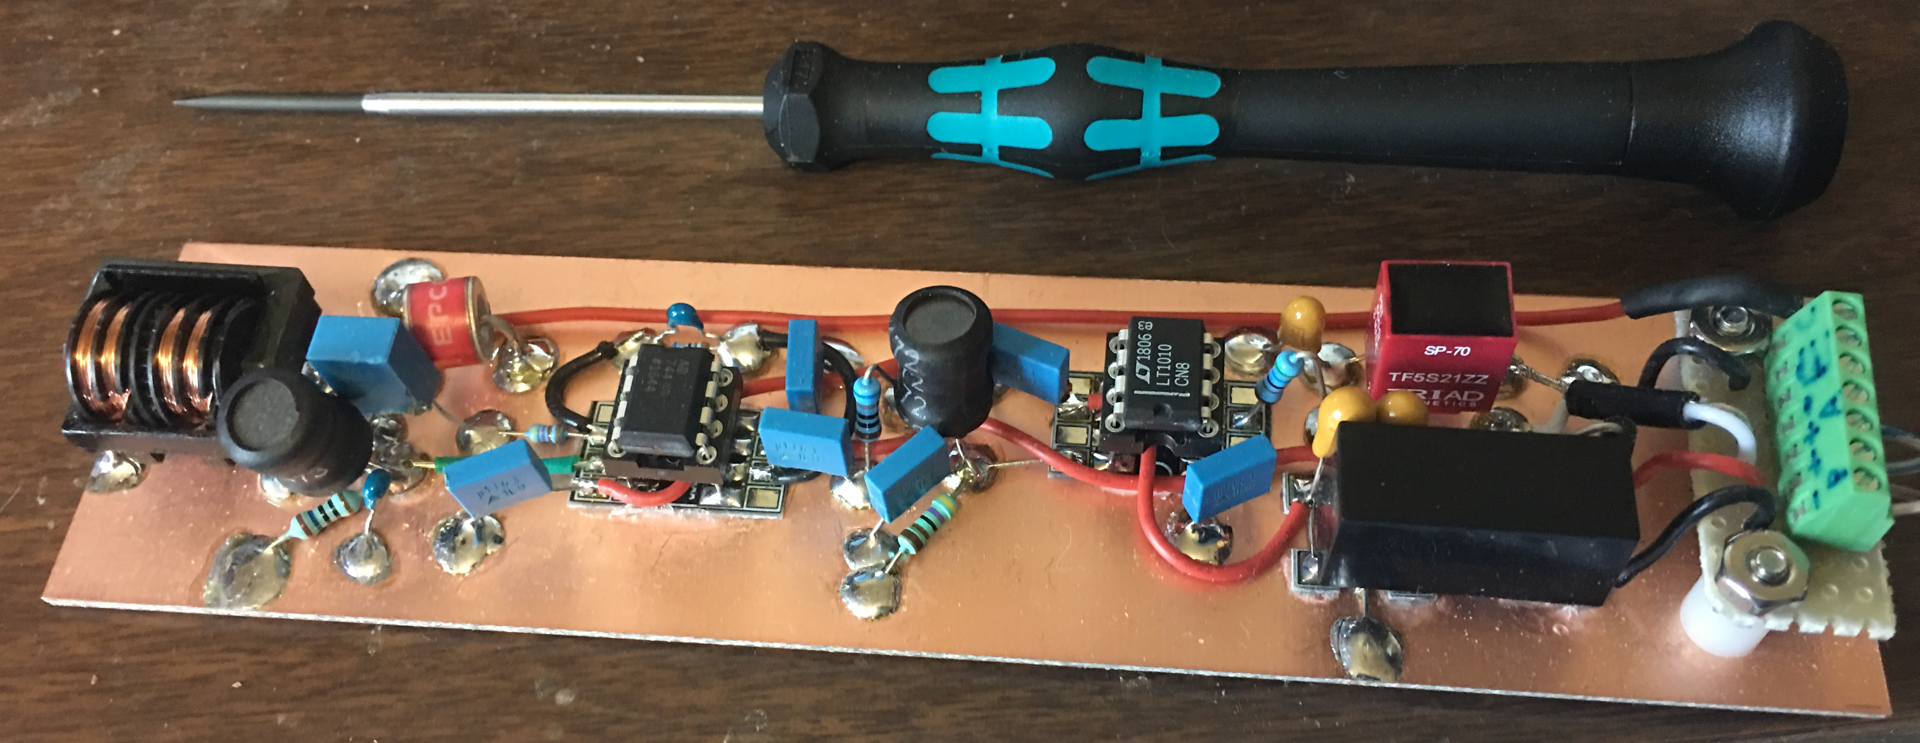



Using a PVC Pipe Antenna and a Raspberry Pi to Detect VLF Natural Radio
Jonathan Rizzo KC3EEY
University of Scranton
Abstract
It's possible to detect half of the world's lightning anywhere on Earth. Because most of a lightning discharge's spectral power is within the Very Low Frequency (VLF) and Ultra Low Frequency (ULF) bands, the emissions from lightning discharges (sferics) propagate rather easily across the globe. These propagation conditions allow for other natural radio events like tweeks, whistlers, and chorus to propagate well within the Earth-ionosphere waveguide. Using a simple E-Field VLF receiver, a GPS timing receiver, a Raspberry Pi with Audioinjector soundcard, it is possible to build a fully contained low power VLF reception system to detect natural radio events in the VLF/ULF band using open source software that will capture, GPS timestamp, and filter (remove mains hum) the VLF audio feed and record, detect individual events, detect sudden ionospheric disturbances, and perform analysis on detected events. VLF event data, recordings, and live streaming is possible, all from a PVC pipe active E-Field antenna receiver, GPS timing receiver, and a Raspberry Pi.
Introduction
Advancements made in VLF Natural Radio automated capture, monitoring, and analysis of Natural Radio has allowed for streamlined reception systems that integrate a VLF receiver inside an antenna housing (in this case, a simple PVC Pipe) as well as isolated power and signal delivery to prevent mains hum from feeding back into the receiver. Previously, the VLF receiver had to be powered by a battery at the receiver site with the audio signal delivered to the PC soundcard with isolation transformer at each end. With the use of isolated DC-DC converters operating at frequencies well above VLF, isolated power delivery to the receiver can be accomplished with a simple wall power supply, all without injecting mains hum into the receiver.
At the other end, a Raspberry Pi 3B with Audioinjector soundcard and GPS timing receiver make up the monitoring, capture, and analysis system utilizing vlfrx-tools. VLF audio is fed into one channel input of the soundcard, while a pulse-per-second signal from a Trimble RES SMT 360 GPS timing receiver is fed into the other channel. vlfrx-tools captures VLF audio and timestamps the signal via the PPS signal. The signal is filtered of mains hum using a notch filter that locates and tracks the 50/60Hz hum. The signal is then passed to event detectors for detection of whistlers, chorus, triggered emissions, and sudden ionospheric disturbances. The signals are also written to disk for storage and streamed to other servers for heavier analysis which includes amateur radio work at VLF using CW and coherent BPSK. Live listening of the filtered signal via Vorbis streaming is also possible and quite useful. This allows the enjoyment of listening to VLF in areas where 50/60Hz hum makes it impossible. Signal streams from other receivers can be combined for TOGA calculations of sferics and whistlers.
Active E-Field Antenna
The VLF receiver in enclosed inside the antenna assembly. The antenna assembly consists of a PVC pipe with foam water pipe insulation inside it. Copper tape has been placed along the length of the pipe insulation which is the antenna element. This arrangement is necessary to ensure microphonic vibrations are kept to a minimum.
The VLF receiver consists of an AD744 input stage with dual ±15V rails. Its gain is dependent on the length of the antenna element, so for a 6-8ft antenna, a gain of ~15 is adequate. High and low pass filtering remove some of the 50/60Hz hum as well as intermodulation affects of AM broadcasts. The output is fed into an LT1010 line driver via further filtering for feeding a long length of cable connecting the receiver to the audio input circuit of the Raspberry Pi soundcard. The LT1010 is also driven with dual ±15V rails. The output of the line driver connects to the primary a high quality audio isolation transformer whose secondary drives the audio feedline. Power is provided by 30-48V on the power feedline to drive an isolated DC-DC converter that supplies ±15V. Electrical isolation is required to prevent 50/60Hz hum from feeding back into the receiver. The receiver was assembled using Manhattan construction.
Raspberry Pi VLF SDR
The VLF receiver’s audio signal and power supply are fed on a shielded cat 5 cable back to an aluminum enclosure containing a Raspberry Pi with Audioinjector soundcard, Trimble RES SMT 360 GPS timing receiver, PPS Piggy interface board for the SMT 360 that interfaces to the Pi via USB serial, a 32GB USB flash drive for VLF data storage, as writing to the SD card continuously will eventually produce write errors. The PPS Piggy produces 3.3V to power the GPS, and the PPS Piggy and Raspberry Pi are powered by a LM2596-based DC-DC converter. DC power for the VLF receiver is provided with an isolated DC-DC converter outputting 30-48V. VLF audio is connected to the right channel of the sound card via an audio isolation transformer. The PPS from the PPS Piggy signal is connected to the left channel as well as a GPIO pin for both signal timestamping and Linux kernel PPS to discipline ntpd. The whole thing is powered with a 12V wall wart.
vlfrx-tools software
VLF audio is captured by the soundcard and GPS timestamped utilizing Paul Nicholson’s vlfrx-tools. The timestamped stream is then filtered of 50/60Hz hum using a tracking filter, then fed into the event detectors to capture whistlers, chorus, and sudden ionospheric disturbances. VLF audio is also streamed for live listening and written to disk for storage. Intricate signal analysis can be performed on the VLF signal via other tools in vlfrx-tools like bearing and distance calculations, TOGA calculations of sferics, and visual representation with gnuplot. Live streams can be streamed to servers across the internet for storage, event detection, and heavier analysis, including amateur radio work at VLF using CW and coherent BPSK.
References
www.auroralchorus.com Steven McGreevy’s N6NKS Web Site
www.abelian.org Paul Nicholson’s Web Site
VLF monitoring, transmission and experimentation Facebook Group
VLF Natural Radio Discussion Group on groups.io (previously Yahoo Groups)
Acknowledgements
Paul Nicholson for his immense effort and work in VLF Natural Radio and VLF Amateur Radio, his technical contributions to myself and VLF community, and his amazing software tools including vlfrx-tools. My passion of VLF Natural Radio was set ablaze by Paul’s contributions and I am eternally grateful.
Steve McGreevy N6NKS for igniting my passion for VLF Natural Radio with his amazing web site, his WR-3 E-Field VLF Receiver, WR9STL H-Field VLF Receiver, and his BBB-4 E-Field VLF Receiver design.
Partially Stapled Productions for Gerbers/BOM of his Trimble GPS timing receiver interface board used in this project.
Dr. Nathaniel Frissell W2NAF for supporting my passion for VLF Natural Radio at the University of Scranton.
The National Science Foundation and the University of Scranton for financial support of this project.
jonathan.rizzo2@scranton.edu
HamSCI Workshop 2020

